Slide 1

CODEATHON UPSOLVE
Passing OS | Varun wants best seat | Knight Knight | Takeshi’s Castle | Min XOR | Tackling Privacy Issues
118 Participants | 756 Submissions
Manan - A Technosurge
JC Bose University of Science and Technology, YMCA
Kartik Bhatia
Sahil Kundu
Sanyam Mittal

Slide 2


Passing OS
To calculate the number of all the jobs a disk can satisfy which are greater than current position of head of Disk. Given Starting point of Disk and Sequence of Jobs in Fixed order
Related Problem - LIS (Using DP)

Slide 3
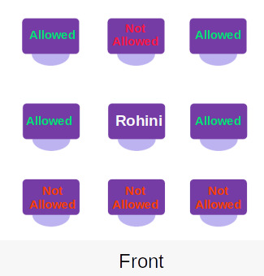
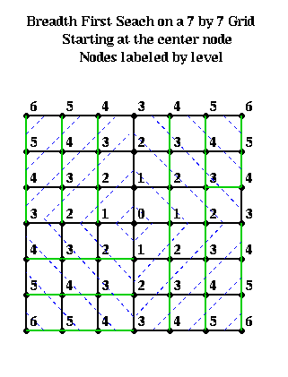
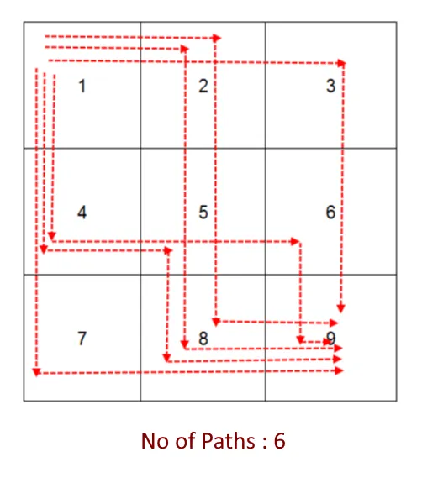
Varun Wants Best Seat
Breadth First Search - BFS
Depth First Search - DFS
Allowed Final Seats

Slide 4
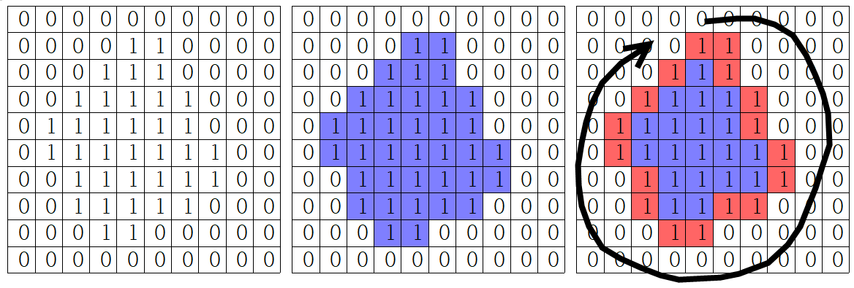
Breadth First Search - BFS
Uses Queue
Generally used for finding minimum distance

Slide 5
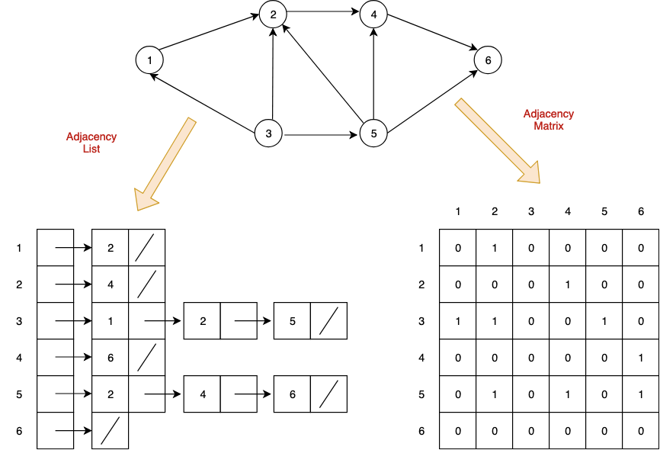
Trees and Graphs

Slide 6
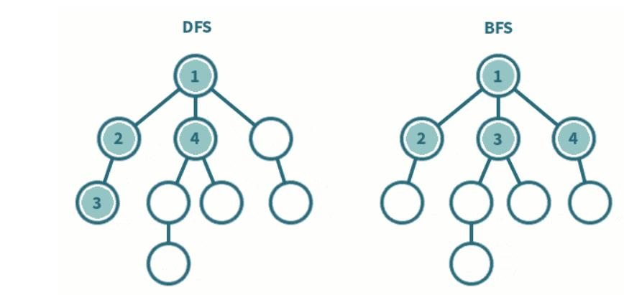
Traversing a Tree

Slide 7
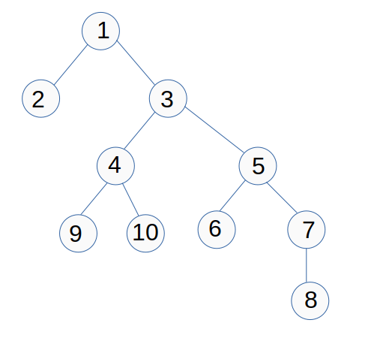
Takeshi’s Castle
Choose randomly any point at starting
BFS/DFS - To Find Distance
Maintain 2 Array for two sides of path
Multiply length or Array 1 with Array 2 and double it.

Slide 8
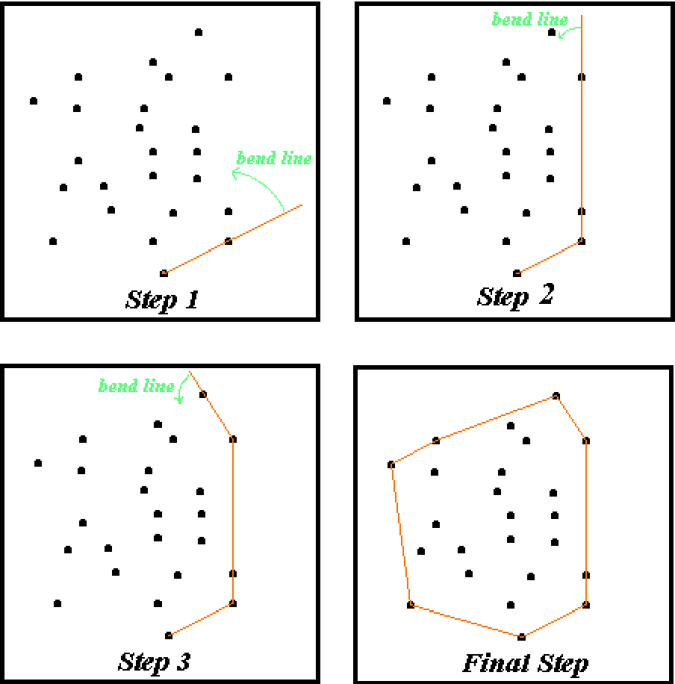
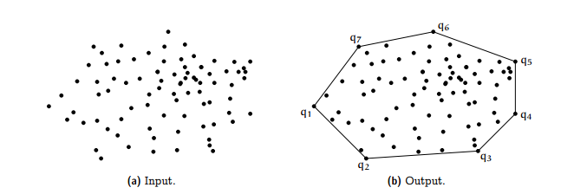
Tackling Privacy Issues
Make a Convex Hull of from all the given points

Slide 9
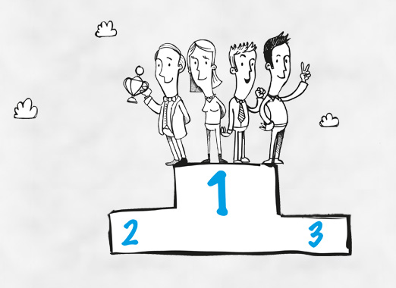
Winners
Shout-out
2nd YEAR
Team Untitled
Members : Shreya Garg and Vivek Aggarwal
Team Shubham Garg
Members : Dipanshu Kalra and Shubham Garg
3rd YEAR
Team BeBright
Members : Payal Mangla and Ajay
Non - YMCAian
Team Bhuwan - team
Members : Bhuwan

Slide 10





Thank You
Follow us on
/manantechnosurge

